Slide 1
CDGC
Databricks Tag Writer
Prototype

Slide 2
What are we trying to do?
Write tags into the Unity Catalog, based on data within the Informatica Catalog
Informatica’s Catalog is very good at classifying the data
Push tags that contain:
Classifications. Rule Base, AI Based, or Manual. It makes no difference. Be able to push all classifications to tags in Databricks.
Business Terms. Push down “business friendly” Terms to the assets in Databricks.
Policies. Push down direct and indirect policies to tags within Databricks.
Also push descriptions to columns and tables
And optionally the link to the informatica Catalog object

Slide 3
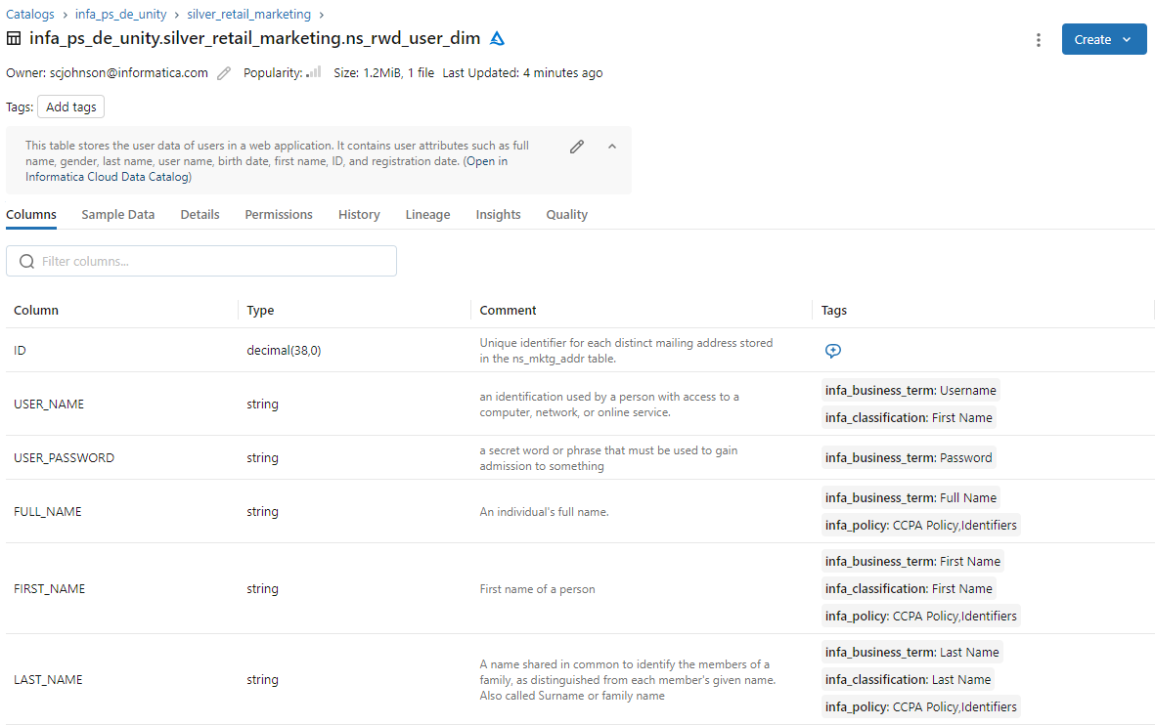
Push Catalog information into Databricks Unity Catalog!
Description of the table, and optionally a link back to the Informatica Catalog
Descriptions of the columns
Tags with:
Glossary Terms
Classifications
Any Policies Related

Slide 4
The approach
Write a Python script that pushes this information to Databricks!

Slide 5
CDGC
Databricks Tag Writer
Prototype
Setup & Running

Slide 6
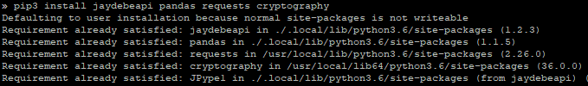
Setup Step 1
Using "pip" ensure the required libraries are installed
pip install jaydebeapi pandas requests cryptography
or
pip3 install jaydebeapi pandas requests cryptography

Slide 7
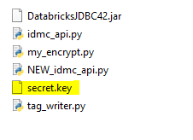
Setup Step 2
Create a secret.key file
python my_encrypt.py
* Note this is the keyfile for our encrypted password. If you share this solution, DON’T SHARE THE secrey.key FILE or it is easy to get the password in clear text!

Slide 8
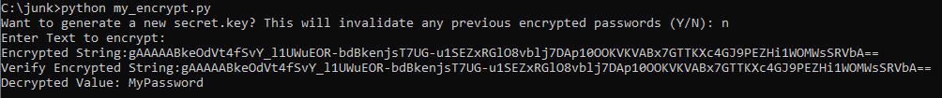
Setup Step 3
Get encrypted passwords by running the my_encrypt.py file
Re-run to generate encrypted passwords.
(When prompted to regen the secret.key, answer "N")
You'll need to do this for the Informatica User's password, and the Snowflake user's password.
Optionally, you can paste that encrypted password back, to verify.

Slide 9
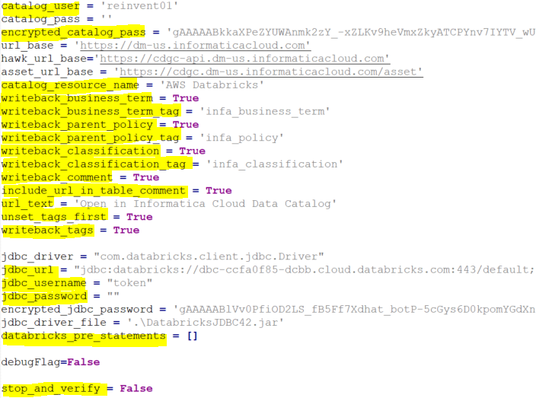
Setup Step 4
Modify the tag_writer.py file and put in your usernames, encrypted passwords, and url_base (Default is the US, change only if in a different region)
Also Specify (as needed):
The name of the Databricks resource that will be evaluated
Whether or not to use business terms, and the name of the existing tag to update
Whether or not to use Policies, and the name of the existing tag to update (will use policies related to the objects, or related to the BT or Classifications related to that object)
Whether or not to use classifications, and the name of the existing tag to update
Whether or not to update comments, and include a link to the Catalog
Option to unset the tags first!
Actually write tags, or just display
JDBC Driver URL, User and Password (encrypted) for Databricks
Any pre statements
Pause before updates

Slide 10

Setup Step 5
Right now, this script uses a JDBC connection, so ensure that you have a JAVA_HOME set

Slide 11
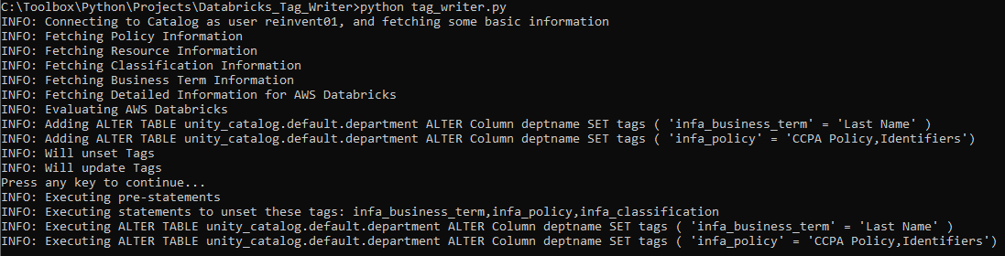
Running
Run the “tag_writer.py" script
python tag_writer.py
or
python3 tag_writer.py
The script will connect and evaluate, and prompt if it’s OK to go ahead and actually update the tags. (It will display the actual update statements)

Slide 12
Thank You
Questions / Issues / Suggestions:
Scott Hayes
shayes@informatica.com

